Slide 1
What Can ML Do For You?
Alumni Event!
Trilogy Education Services
| May 10, 2018

Slide 2
Outline:
Debunking Myths
Basic Definitions
Problem Types
Model Fit Predict
Common Algorithms
Beyond X and Y
Live Demos

Slide 3
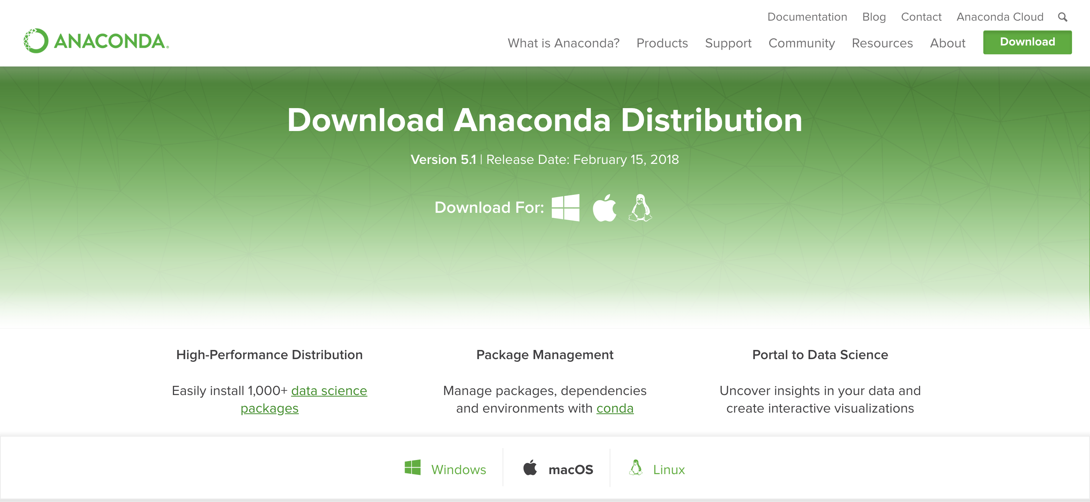
If You’d Like to Follow Along (Or Review Later):
https://www.anaconda.com/download/#macos
Once installed open python and run the command
`conda install scikit-learn`

Slide 4
Debunking Myths

Slide 5
The Mysticism of ML

Slide 7
The Future of Machine Learning
I foresee a day when Machine Learning is relegated to a world of the off-the-shelf formulas readily available by the masses. We’re already nearly there…

Slide 8
Basic Definitions

Slide 9
Machine Learning in a Nutshell…
Statistics
Libraries

Slide 10
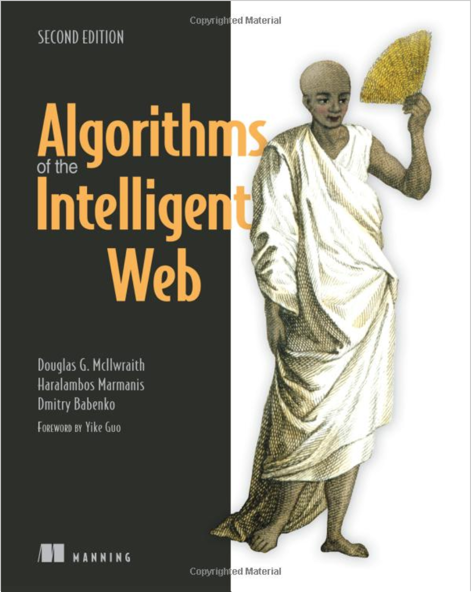
Intelligent Algorithms (Definition)
“Intelligent Algorithms are ones that use data to modify its behavior. Intelligent algorithms differ in that they can change their behavior as they run, often resulting in a user experience that many would say is intelligent.”

Slide 11
Intelligent Algorithms (Triad)
Capability of software to generalize phenomena (past or future) based on past experience.
Machine Learning
Capability of software to predict future outcomes based on historic data
Software (and machines) that have a series of options to achieve a particular goal
Predictive Analytics
Artificial Intelligence

Slide 12
Intelligent Algorithms (Diagram)
Data
Intelligent Algorithm
Event
Decision
Intelligent algorithms are ones that respond to data such that the algorithm gets better. It effectively “evolves”. The decision is no longer deterministic given the event.

Slide 13
Artificial Intelligence (Example)

Slide 14
Predictive Analytics (Example)

Slide 15
Intelligent Algorithms (Triad)
Capability of software to generalize phenomena (past or future) based on past experience.
Machine Learning
Predictive Analytics
Artificial Intelligence

Slide 16
Problem Types

Slide 17
Machine Learning (Taxonomy)

Slide 18
Machine Learning (Taxonomy)
Unsupervised Learning
Supervised Learning

Slide 19
Machine Learning (Categories)
Supervised Learning:
Algorithms for which the potential outcomes are knowable in advance (i.e. category or numeric range)
Example 1: Using data about an individual’s age, behaviors, and pre-existing health conditions -- determining whether an individual is at risk of a chronic condition (Known Category: “Risk” vs. “Not Risk”).
Example 2: Using data about an individual’s grades, demographics, and background – determining whether we can predict an individual’s grade point average. (Numeric Range: 0 to 100).

Slide 20
Machine Learning (Categories)
Unsupervised Learning:
Algorithms for which the potential outcomes are not knowable in advance (i.e. we are relying on our algorithm to define the customer segments in our analysis)
Example 1: Using data obtained from viewers of Netflix, we are trying to identify new segments of customer viewing patterns (i.e. “Viewers who like Strong Leading Female Actresses”)
Note: Determining who likes a particular type of film is not an example of an unsupervised learning problem. (Yes / No would be an outcome).

Slide 21
Quick Check!
What’s the difference between supervised and unsupervised learning?
Which type of learning would the following circumstances be?
Dating App is powered by a machine learning algorithm. The Dating App predicts whether the user will like or not-like a particular match.
Coca Cola is using machine learning to identify customer targeting strategies. It wants to identify if there are particular types of customers who could be served by a new type of drink.
AirBNB is looking to create a machine learning algorithm that flags properties as being: “Untapped Hot Destinations”. It wants to use pre-existing data on successful destinations to make the determination.
Food Rating App is powered by a machine learning algorithm. As you rate restaurants, it becomes increasingly better at suggesting restaurants you might like in the future.
3. What is another example of supervised learning you can think of?

Slide 22
Quick Check!
What’s the difference between supervised and unsupervised learning?
Which type of learning would the following circumstances be?
Dating App is powered by a machine learning algorithm. The Dating App predicts whether the user will like or not-like a particular match. Supervised
Coca Cola is using machine learning to identify customer targeting strategies. It wants to identify if there are particular types of customers who could be served by a new type of drink. Unsupervised
AirBNB is looking to create a machine learning algorithm that flags properties as being: “Untapped Hot Destinations”. It wants to use pre-existing data on successful destinations to make the determination. Supervised
Food Rating App is powered by a machine learning algorithm. As you rate restaurants, it becomes increasingly better at suggesting restaurants you might like in the future. Supervised
3. What is another example of supervised learning you can think of?

Slide 23
Machine Learning (Taxonomy)

Slide 24
Machine Learning (Problem Types)
Classification:
Applying Labels to Data
Clustering: Finding groups within a population
Regression:
Fitting Data to predict where a new data point lies

Slide 25
Machine Learning (Regression)
Most of us are familiar with the idea of regression. We use it to predict one variable’s value using another.
The power of ML tools is that we will be able to quickly solve problems for which multiple variables predict another.

Slide 26
Machine Learning (Problem Types)
Regression
Algorithm for which we are trying to use one set of variables to predict the value of another (typically along a quantitative range).
Example 1: Based on what we understand about a person’s demographic, gender, age and time playing a mobile game – can we predict the total amount they will spend on in-game purchases?
Example 2: Based on what we understand about time of year, the daily sentiment on social media, and the country’s unemployment rate – can we predict the % change in bitcoin price the next day?

Slide 27
Machine Learning (Problem Types)
Classification
Algorithm for which we are trying to determine which of a discrete number of groups an unclassified data point falls into.
Example 1: Based on what we know about a customer’s age, gender, location, stated hobbies, and total purchase history this year – will they purchase an Amazon Echo this year?
Example 2: Based on the face length, roundness, forehead size, and amount of hair – is the gender of an image shown more likely to be a male or female?

Slide 28
Machine Learning (Classification)
For most of our purposes at Trilogy, Classification problems are often the most frequent ones we face.
In our world, we often have multiple “features” about an individual or classroom and we are trying to decide which category this means it falls into.

Slide 29
Machine Learning (Classification)
In classification problems our focus is in identifying which pre-defined label our data falls into based on the features we have.

Slide 30
Machine Learning (Classification)
Training Data (Pre-Classified)
Number of Exclamations | Number of “Buy” phrases | Number of Spelling Mistakes | Number of “$” References | Word Length of Sentences | Presence of Name | Classification
10 | 7 | 20 | 5 | 3 | False | SPAM
3 | 0 | 2 | 0 | 8 | True | Not Spam
Unknown Data (Unclassified)
Number of Exclamations | Number of “Buy” phrases | Number of Spelling Mistakes | Number of “$” References | Word Length of Sentences | Presence of Name | Classification
13 | 6 | 0 | 2 | 4 | True | ??
In classification problems our focus is in identifying which pre-defined label our data falls into based on the features we have.

Slide 31
Machine Learning (Problem Types)
Clustering
Algorithm for which we are trying to determine the optimal way to group items for which we have no pre-defined classification
Example 1: We would like to group our enrollments into categories of “like-students” based on a set of variables. We have no preconceived notions as to how these groups will be shaped. What’s the optimal way to segment and associate them?

Slide 32
Machine Learning (Clustering)
In this clustering problem we expect our algorithm to find the groupings of data point based on location.
Time to Enroll
Coding Test Score

Slide 33
Machine Learning (Clustering)
In this clustering problem we expect our algorithm to find the groupings of data point based on location.
Kn=3
Time to Enroll
Coding Test Score

Slide 34
Machine Learning (Clustering)
But the problem is more complex…
Kn=2
Time to Enroll
Coding Test Score

Slide 35
Machine Learning (Clustering)
…Because perhaps the clusters are not where we think they are.
Kn=2
Time to Enroll
Coding Test Score

Slide 36
Quick Check!
How would you define: Regression, Classification, and Clustering?
Which problem type would each of the following circumstances be?
Dating App is powered by a machine learning algorithm. The Dating App predicts whether the user will like or not-like a particular match.
Coca Cola is using machine learning to identify customer targeting strategies. It wants to identify if there are particular types of customers who could be served by a new type of drink.
AirBNB is looking to create a machine learning algorithm that flags properties as being: “Untapped Hot Destinations”. It wants to use pre-existing data on successful destinations to make the determination.
NBA analysis looks at data around average minutes played last season, previous season point average, years in the league, position, height, weight, and bmi to predict the number of points a player will likely average in the coming season.
3. What is another example of each that you you can think of?

Slide 37
Quick Check!
How would you define: Regression, Classification, and Clustering?
Which problem type would each of the following circumstances be?
Dating App is powered by a machine learning algorithm. The Dating App predicts whether the user will like or not-like a particular match. Classification
Coca Cola is using machine learning to identify customer targeting strategies. It wants to identify if there are particular types of customers who could be served by a new type of drink. Clustering
AirBNB is looking to create a machine learning algorithm that flags properties as being: “Untapped Hot Destinations”. It wants to use pre-existing data on successful destinations to make the determination. Classification
NBA analysis looks at data around average minutes played last season, previous season point average, years in the league, position, height, weight, and bmi to predict the number of points a player will likely average in the coming season. Regression
3. What is another example of each that you you can think of?

Slide 38
Model-Fit-Predict

Slide 39
Training and Predicting
Regardless of the problem type, in Machine Learning we follow a familiar paradigm.
Model -> Fit (Train) -> Predict

Slide 40
Training and Predicting
A | B | C | Class
11 | 16 | 22 | 1
10 | 8 | 4 | 2
… | … | … | …
A | B | C | Class
10 | 15 | 23 | ?
Apply
Data
Train / Fit
Model
Class
1
Predict
Regardless of the problem type, in Machine Learning we follow a familiar paradigm.
Model -> Fit (Train) -> Predict

Slide 41
Many Models… Which To Choose?

Slide 42
Common Algorithms

Slide 43
Training and Predicting
A | B | C | Class
11 | 16 | 22 | 1
10 | 8 | 4 | 2
… | … | … | …
A | B | C | Class
10 | 15 | 23 | ?
Apply
Data
Train / Fit
Model
Class
1
Predict
Regardless of the problem type, in Machine Learning we follow a familiar paradigm.
Model -> Fit (Train) -> Predict

Slide 44
Many Models… Which To Choose?

Slide 45
Foundational Algorithms
Regression
Understanding these four algorithms will give you a foundation to start testing ML algorithms on your data.
Multiple Linear Regression
But don’t worry… our tools will do the “hard work”
Classification
Logistic Regression
Decision Tree
Random Forest

Slide 46
Foundational Algorithms
Regression
But don’t worry… our tools will do the “hard work”
Multiple Linear Regression
Classification
Logistic Regression
Decision Tree
Random Forest

Slide 47
Algorithm #1: Multiple Linear Regression
In multiple linear regression, we apply a weight to each of the explanatory variables to determine the resulting variable.
A few Notes:
Once we get past three variables, we can no longer graph the data in an intuitive way. We must rely on our algorithm’s score and accuracy to evaluate its success.
The size of the weight does not mean that a variable is more important. It could just mean that the variable in question is of a larger scale than others (Example: Population vs. % Employed).

Slide 48
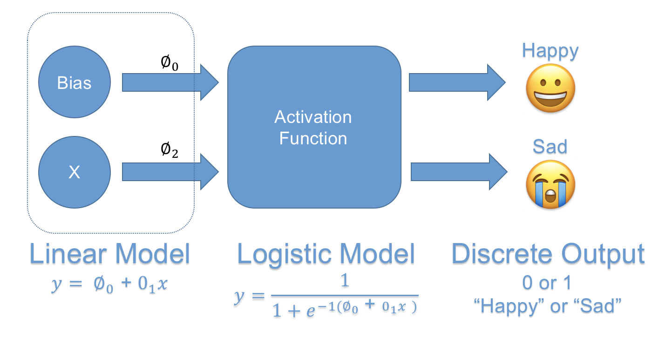
Algorithm #2: Logistic Regression
In logistic regression, we map our linear function to produce a discrete set of classes. It relies on a statistical formula.
A few Notes:
The scary math aside, logistic regression is very likely the only algorithm you need for classification. It’s a quick and dirty way to run ML on a dataset to see if there is a compelling story. Industry often solely relies on logistic regression.

Slide 49
Algorithm #3: Decision Trees
In a decision tree, our algorithm creates a deeply nested set of conditionals that captures every possible combination of conditions. We then use this set of conditionals to make predictions on unknown data points.
Note: Many GUI based tools like BigML make it easy to create visual decision trees. They sometimes take longer to produce, but can be a nice counter test vs. logistic regression.

Slide 50
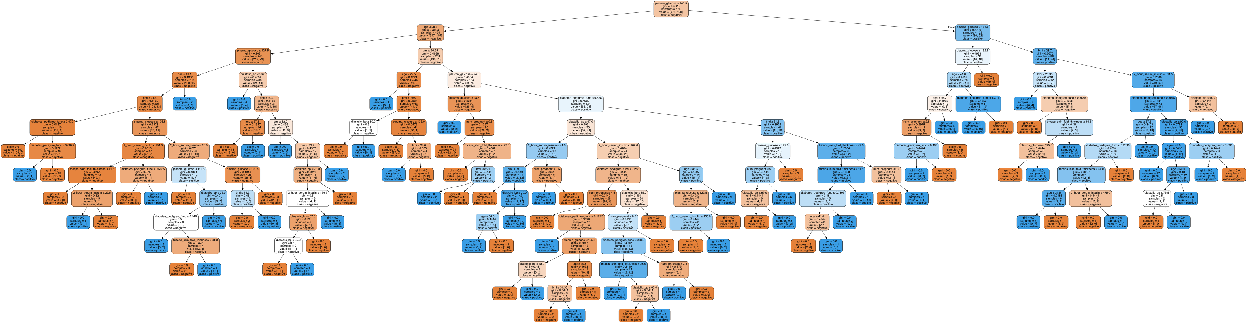
Algorithm #3: Decision Trees
Decision trees can become massive very quickly…
This is where “Random Forests” come in.

Slide 51
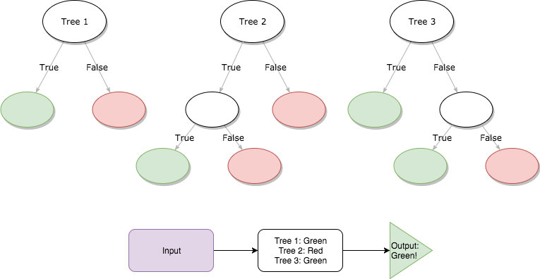
Algorithm #4: Random Forest
In a random forest we create an ensemble of smaller decision trees. We then average the results across each of the decision trees to determine the outcome.
Note: Many GUI based tools like BigML default to Random Forest for classifications, which makes understanding them conceptually important.

Slide 52
Training and Predicting
A | B | C | Class
11 | 16 | 22 | 1
10 | 8 | 4 | 2
… | … | … | …
A | B | C | Class
10 | 15 | 23 | ?
Apply
Data
Train / Fit
Model
Class
1
Predict
But remember! All these models are going to become “black boxes” for us.

Slide 53
Beyond x and y

Slide 54
Remember This?
… As simple as it seems, it’s the basis of modelling.

Slide 55
Lines and Formulas
Happiness = 1.2 * Hours Slept – 0.9
The takeaway from middle statistics is that we can create formulas that relate how one variable predicts another.

Slide 56
When Lines Learn to Curve
As we get more sophisticated, we can break free from linear models to instead pursue models that follow alternative patterns (exponential, power, logarithmic, etc.)

Slide 57
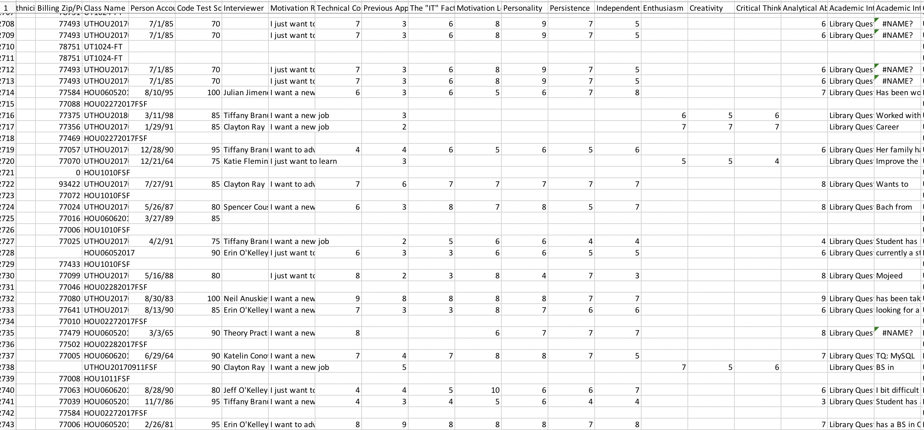
The Limits of x and y
Much of the time, this is what our data looks like – multiple columns congealed into a barely decipherable stream of consciousness. So what is “x” in this case?

Slide 58
Introducing “X”
X (Note that this is capital X signifying multiple variables)
Previous Season Point Average | Previous Season Minutes Played | Years in League | Position | Height | Weight
35 | 65 | 2 | Center | 80 | 200
5 | 8 | 5 | Guard | 65 | 175
y
Expected Points Next Season
37
2
With ML “X” can be everything.
All of it. All at once.

Slide 59
Multi-Variable Modelling
Different algorithms use the multiple variables in different ways, but each ultimately produces the same “y” we are looking for.

Slide 60
Evaluating Algorithms

Slide 61
Basic Premise of Scoring
Full Data Set (Historic)
N=1000
GPA | Risk Count | Support | NPS Category
65 | 2 | 2.5 | Detractor
90 | 0 | 4.8 | Promoter
… | … | … | …
Training Data Set
Testing Data Set
GPA | RC | S | NPS
76 | 3 | 2.1 | Detractor
84 | 1 | 2.9 | Neutral
… | … | … | …
GPA | RC | S | NPS
65 | 3 | 2.5 | HIDE
91 | 1 | 4.2 | HIDE
… | … | …
N=800
N=200
We will cut a slice of this data (80%) to
“build our model” then use it to predict the values for the remaining 20%.

Slide 62
Basic Premise of Scoring
Model
GPA | RC | S | NPS (Predicted) | NPS (Actual)
65 | 3 | 2.5 | Detractor | Detractor
91 | 1 | 4.2 | Promoter | Neutral
… | … | …
Testing Data Set
N=200
We can then compare the NPS of our Prediction vs. the NPS Actual. Based roughly on how often we are “correct”, we get a score for the model as a whole. If the model scores well, then we can trust it for future use.

Slide 63
Common Scoring Metrics
R² (R-Squared): This is the baseline metric that many ML tools report on score. Higher R² values signify that the model is “highly predictive”. An R² value of >0.90 means that our model roughly accounts for 90% of the variability.
Sensitivity and Specificity
TPR: True Positive Rate
TNR: True Negative Rate
FPR: False Positive Rate
FNR: False Negative Rate

Slide 64
Example Application

Slide 65
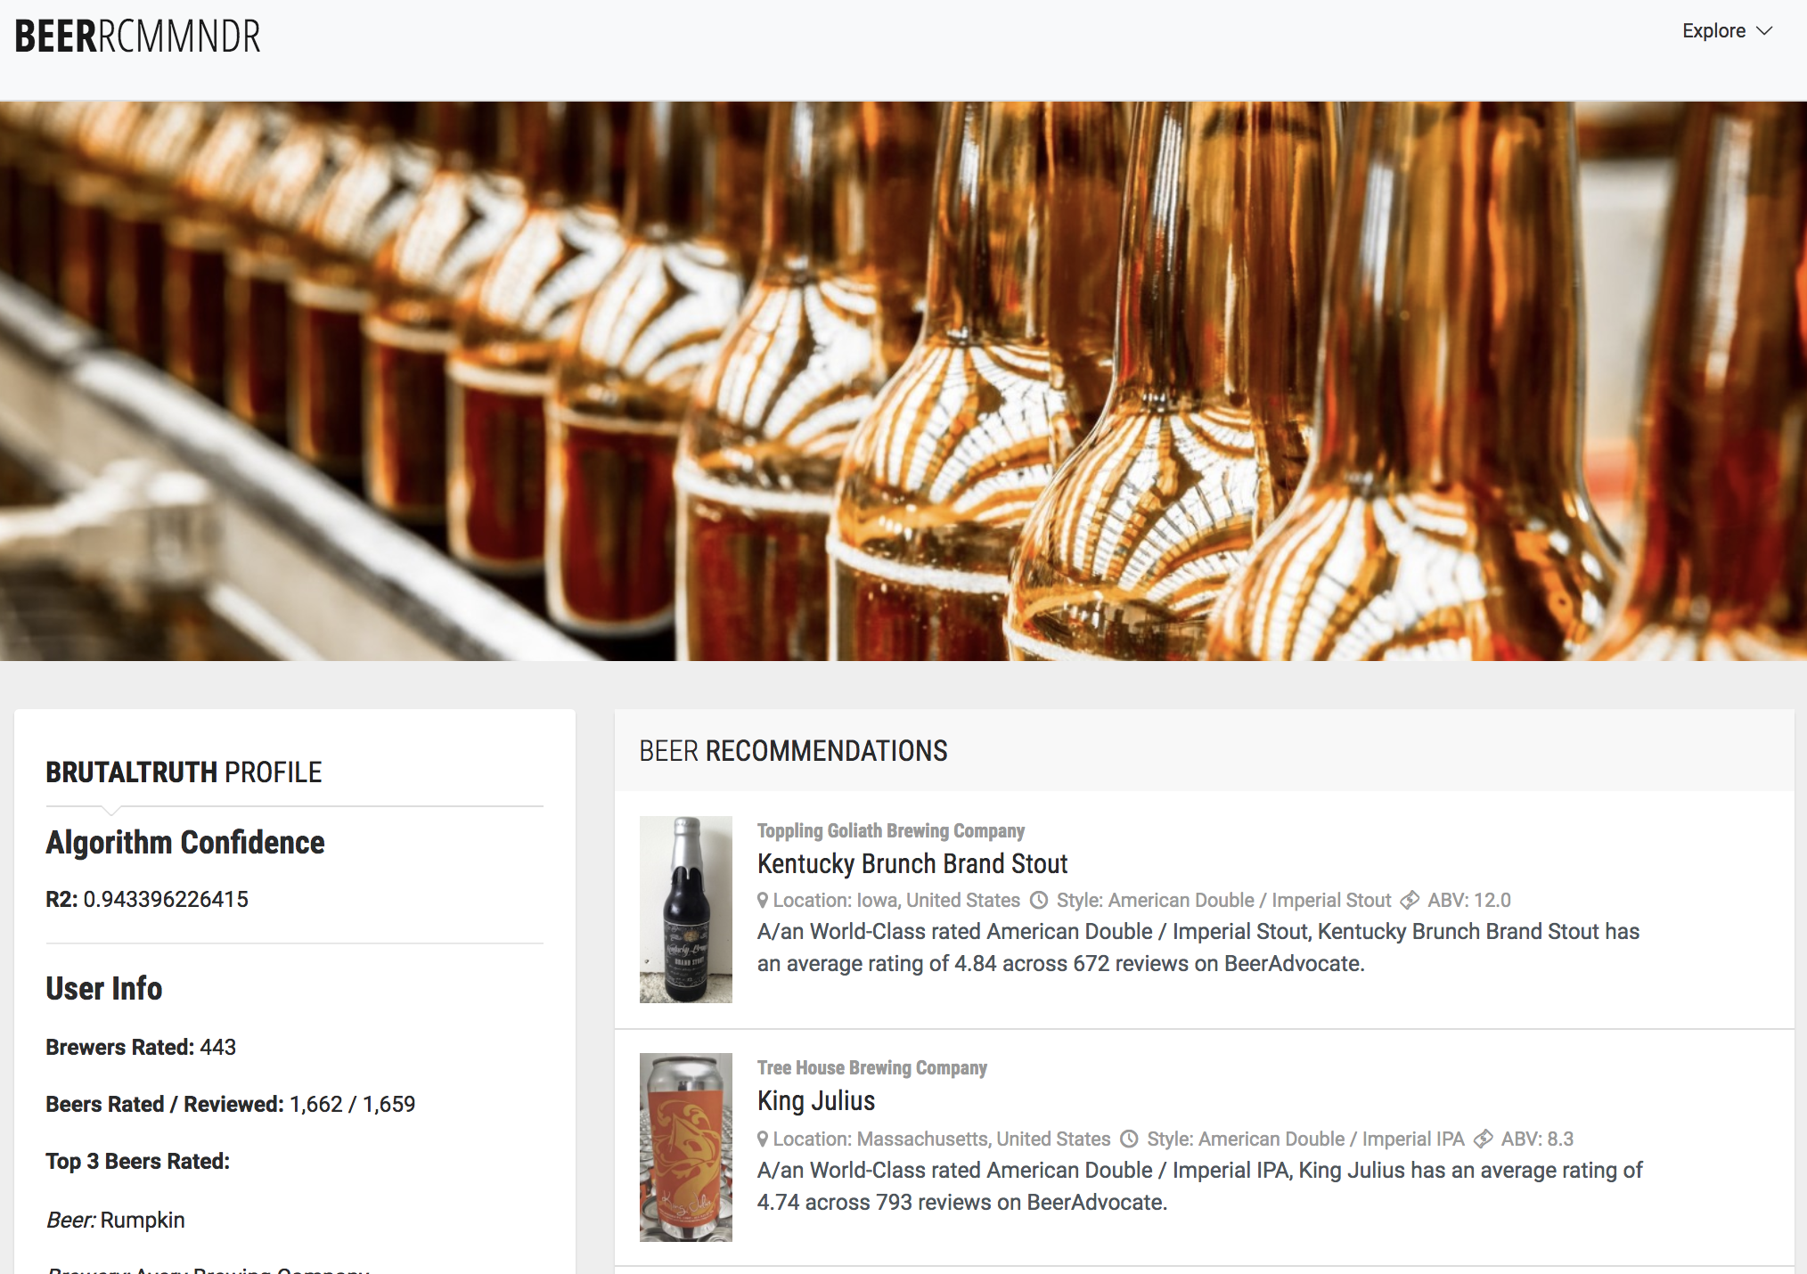
Why We Teach… Data Analytics
Students developed a full-fledged web application that scrapes a Beer Advocate’s reviews, passes them through a custom built—machine learning algorithm, then responds with beer recommendations.
BEERCOMMDNER
Helps consumers pick their next favorite beer through the power of machine learning! (User: SAMLOVER55, jdguggs10)

Slide 66
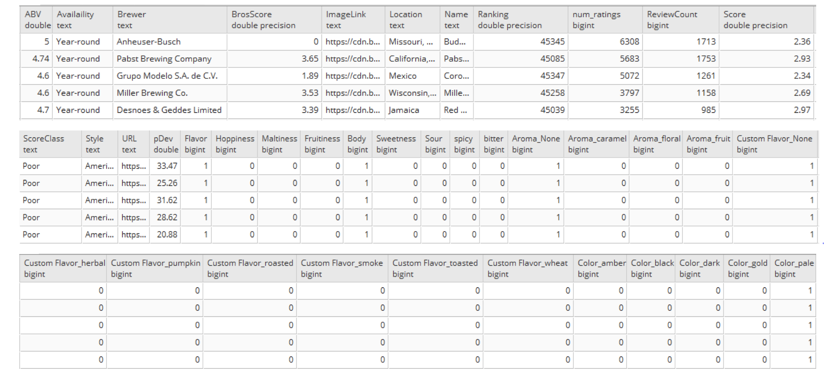
Why We Teach… Data Analytics
Students ultimately created a model that analyzed 30,000 beers across 40 features to identify associations of preference.

Slide 67
Okay! No more talk!
Time to Model!

Slide 68
Live Demo

Slide 69
Questions / Discussion

